Slide 1
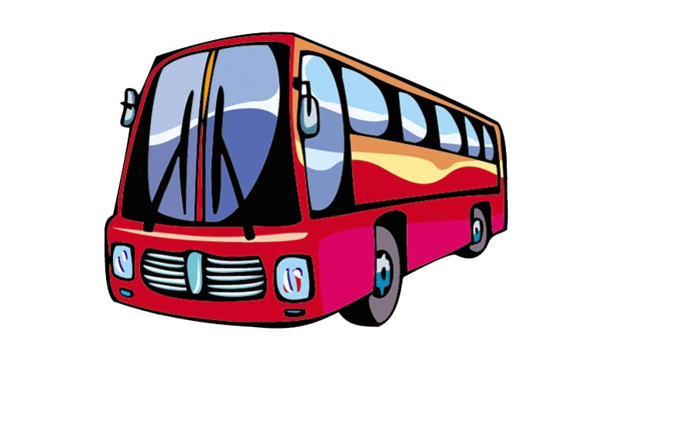
Booking System Presentation
Streamlining Bus Reservations with RedBus:
Submitted to: MR. RISHI KUMAR Submitted by: KANISHKA
MEGHA YADAV
DIVYANSHU VATS
KAPIL DANGWAL
GROUP H HIMANSHU JAIN

Slide 2

TABLE OF CONTENTS:
INTRODUCTION
BUS ROUTES AND TIMINGS
Ticketing Details and Availability
RedBus Reservation System
Ticket Generation Process Via RedBus
Sample RedBus Ticket
Conclusion
Q&A Session

Slide 3
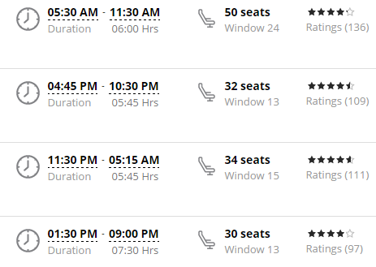


INTRODUCTION
Introduction to Bus Tickets: Imagine easily booking a bus ticket from one city to another hassle-free.
Why Efficient Reservations Matter: Quick and convenient bookings mean no more long queues or last-minute stress.
What to Expect: Learn about easy booking steps, cost details, and availability in this presentation is like buying a pass to travel on a bus. It's a system that helps people book seats for their trips from one city to another.

Slide 4
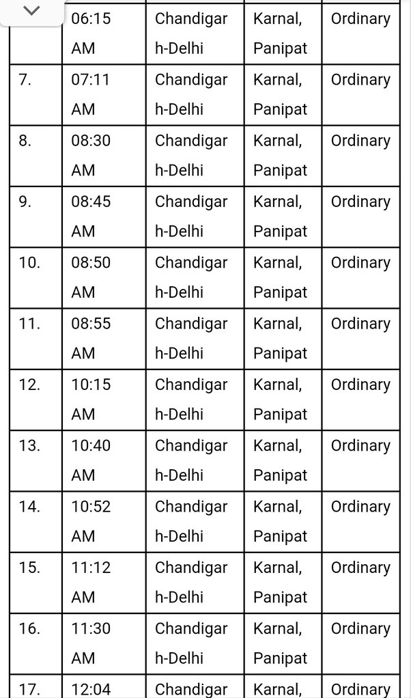
BUS ROUTES AND TIMINGS:
Cities Served: Explore various cities linked by our bus system, connecting you conveniently.
Routes and Stops: Discover different routes like City A to City B, each with multiple stops along the way.
Timings and Frequencies: Learn about the departure timings and frequency of buses on these routes.

Slide 5
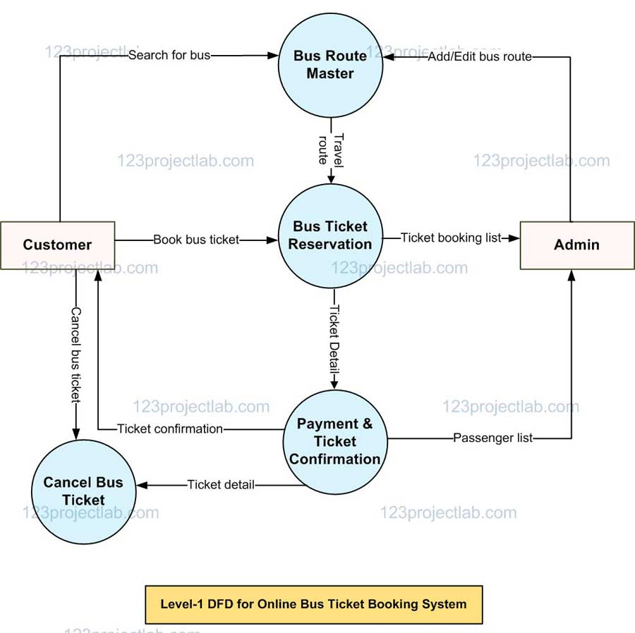
Ticketing Details and Availability:
Ticket Costs: Explore affordable ticket prices sourced from the Uttarakhand Bus Transit System.
Availability Management: Understand how we manage ticket availability to ensure a smooth booking process.
Booking Process: Learn how passengers can easily book tickets based on availability.

Slide 6
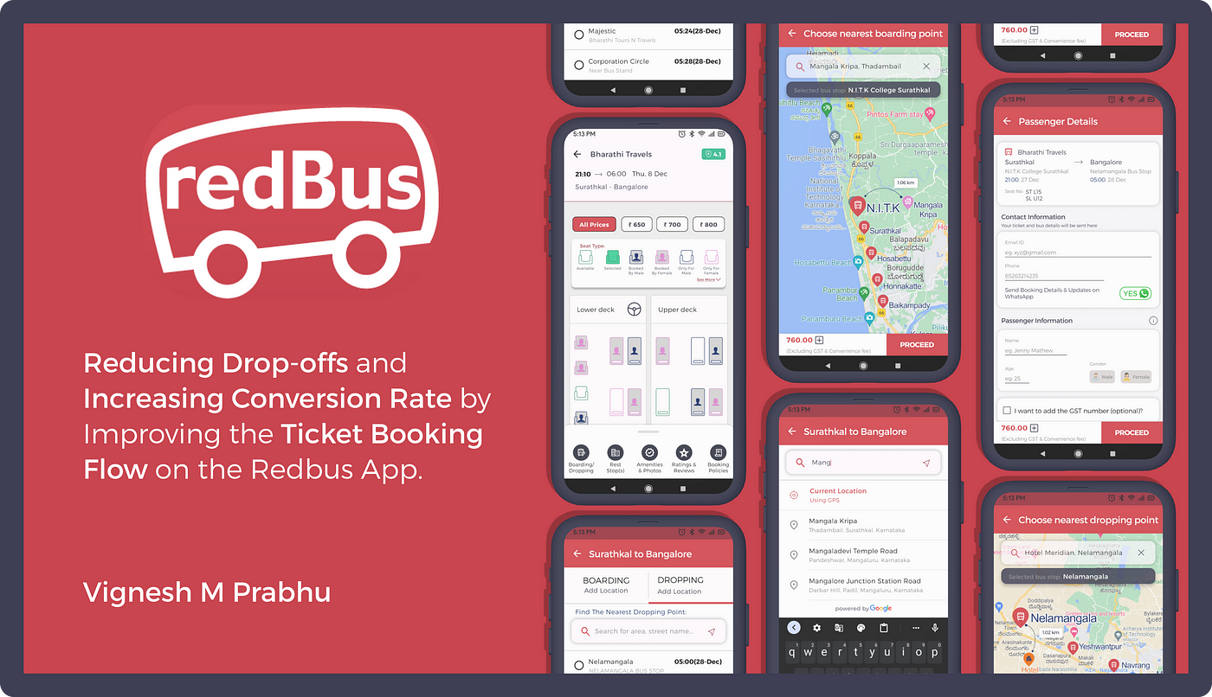
RedBus Reservation System:
Platform Overview: Explore the user-friendly interface and features of the RedBus reservation platform.
Accessing the System: Learn how easily users can access the RedBus system for booking tickets.
Benefits and Features: Discover the advantages and key features of using RedBus for hassle-free ticket reservations.

Slide 7
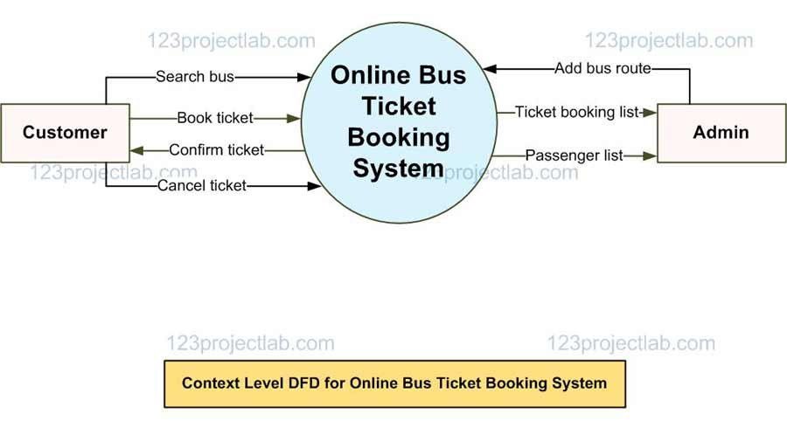
Ticket Generation Process Via RedBus:
Step-by-Step Guide: Demonstrating the process of generating a bus ticket through RedBus.
Selection Process: Display how users can select their route, date, and specify the number of passengers.
Ticket Details: Showcase a summary of the information included in the generated ticket (journey details, passenger info, seat numbers, cost breakdown).

Slide 8
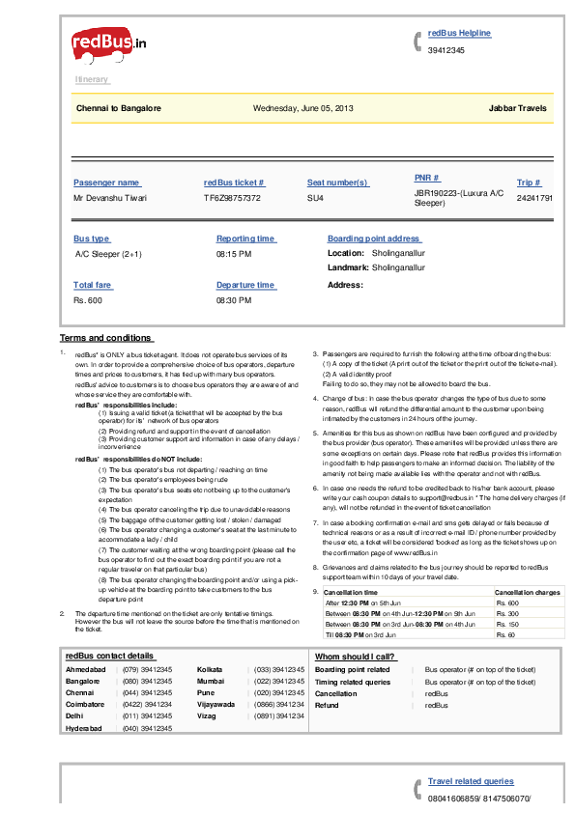
Sample RedBus Ticket:
Generated Ticket Sample: Display a visual representation of a sample bus ticket obtained from RedBus.
Highlighted Information:
Departure and Arrival Times
Seat Numbers
Passenger Details (names, ages, if applicable)
Fare and Cost Details

Slide 9

Conclusion
Benefits of Using RedBus:
Hassle-free and convenient ticket booking process
Wide range of available bus routes and timings
Real-time seat availability information
Secure and reliable payment options
Encouragement:
We encourage you to experience the convenience of RedBus for your next journey!
Contact Information:
For inquiries or assistance, reach us at:
Email: support@redbus.com
Phone: +1-800-REDBUS-HELP

Slide 10
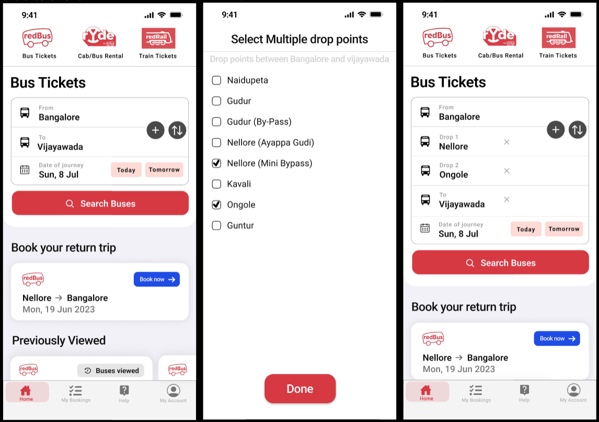
Q&A Session:
Let's talk further about the Bus Ticketing System and RedBus! Share your thoughts, ask questions, and explore more.

Slide 11
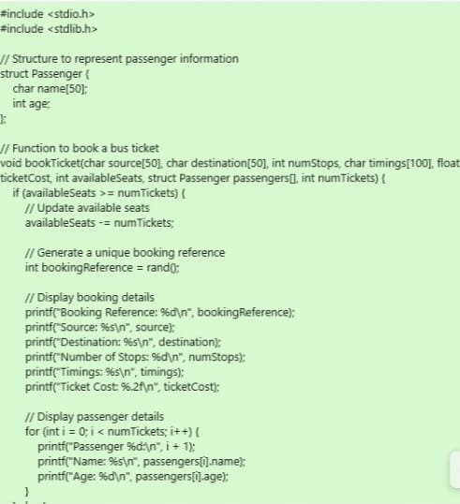
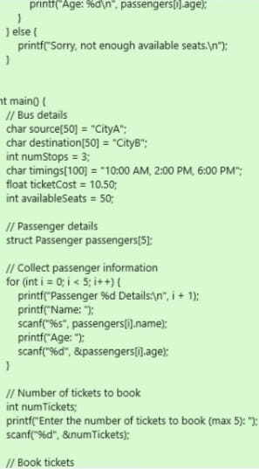
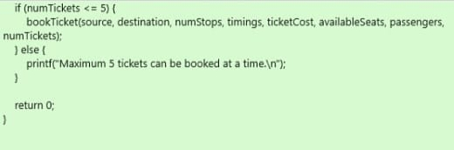
CODE:-

Slide 12
A SIMPLIFIED CODE:-
WHAT IT DOES?
The provided code is a simple bus ticket booking system written in C. When you run this code, it will prompt you to enter details for up to 5 passengers, such as their names and ages. After collecting passenger information, it will then ask you to enter the number of tickets to book.If the number of tickets entered is valid (less than or equal to 5) and there are enough available seats on the bus, it will simulate booking the tickets. It will generate a unique booking reference, display the details of the booked bus, and show the details of each passenger.

Slide 13
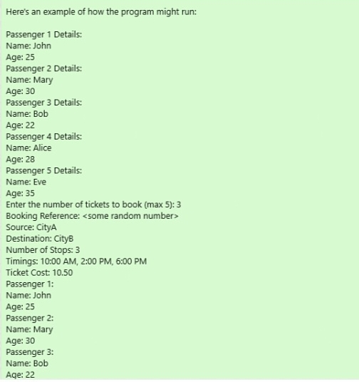


Slide 14

THANKYOU

